Slide 1

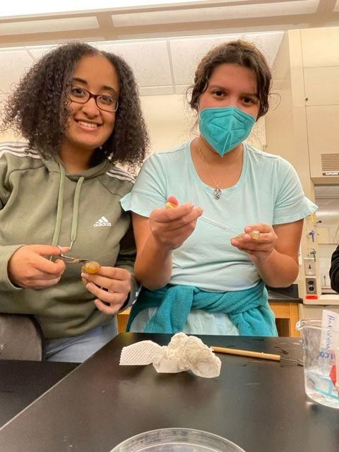

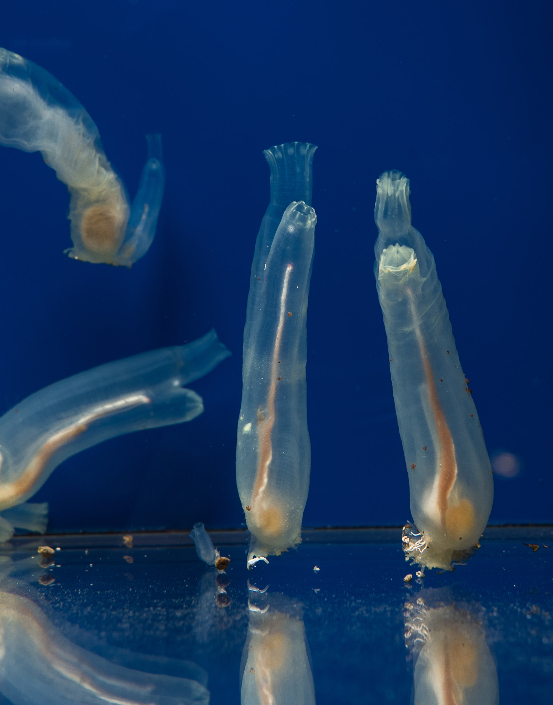
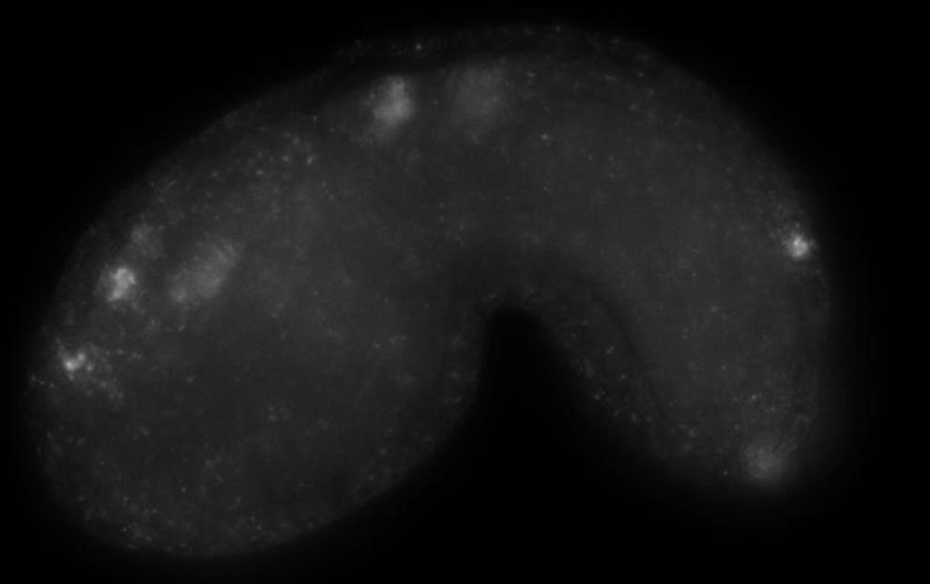
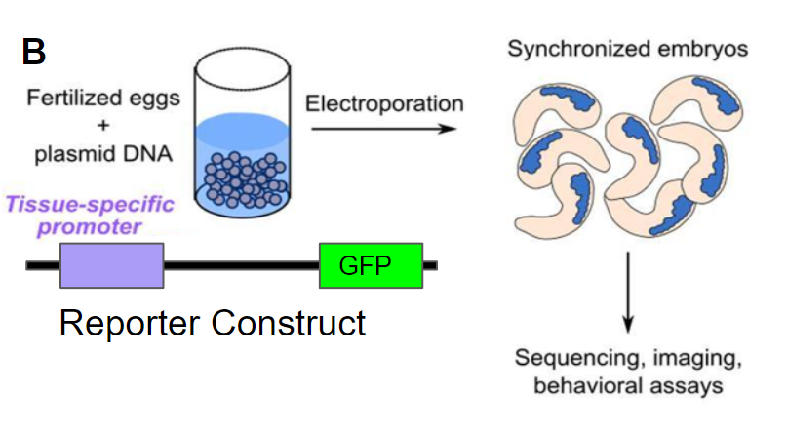
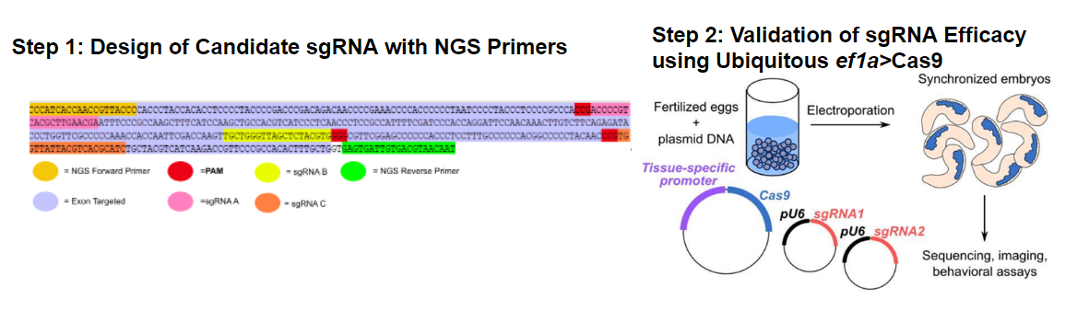
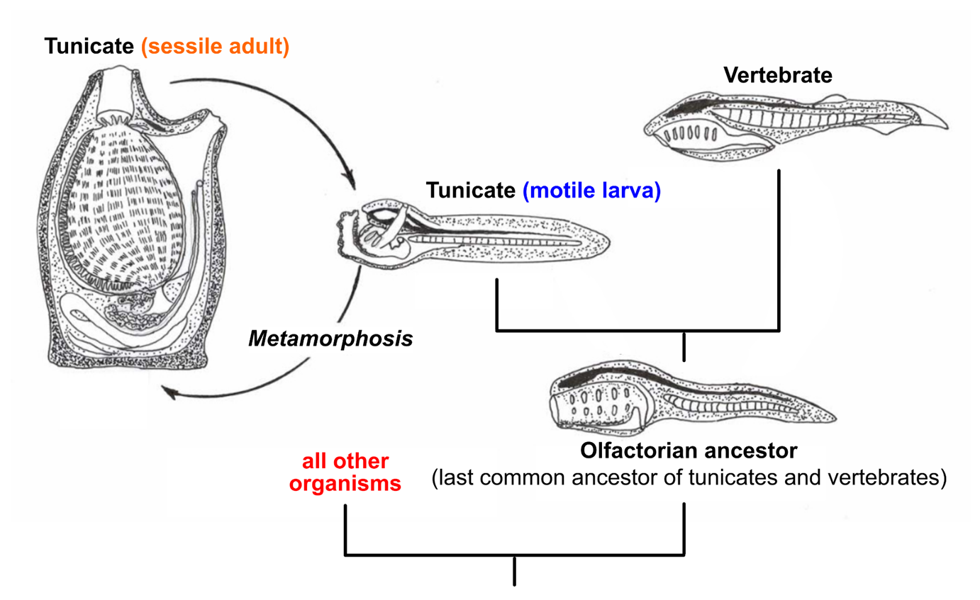
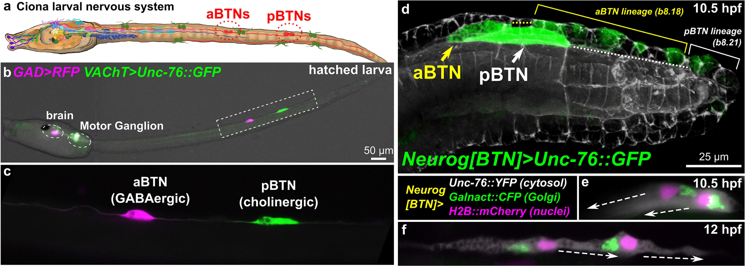
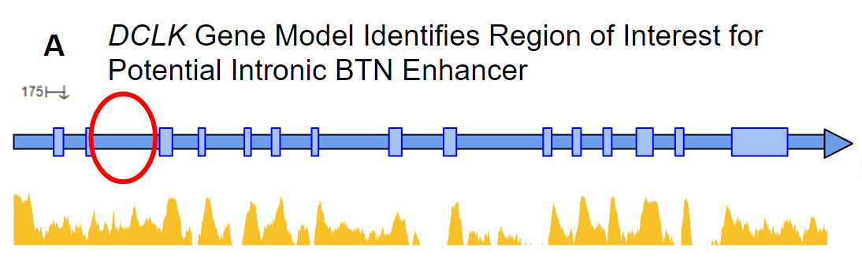
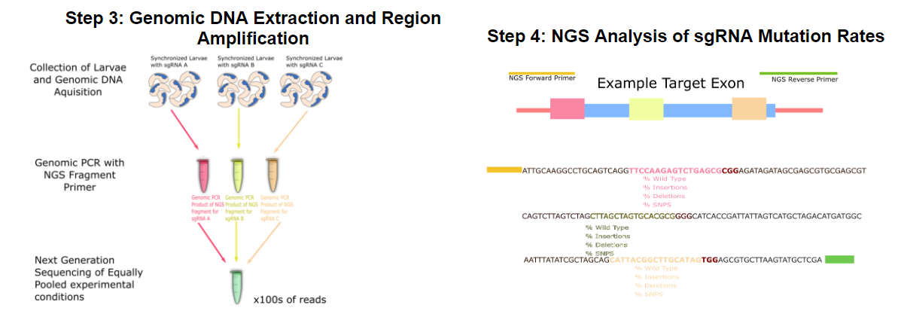
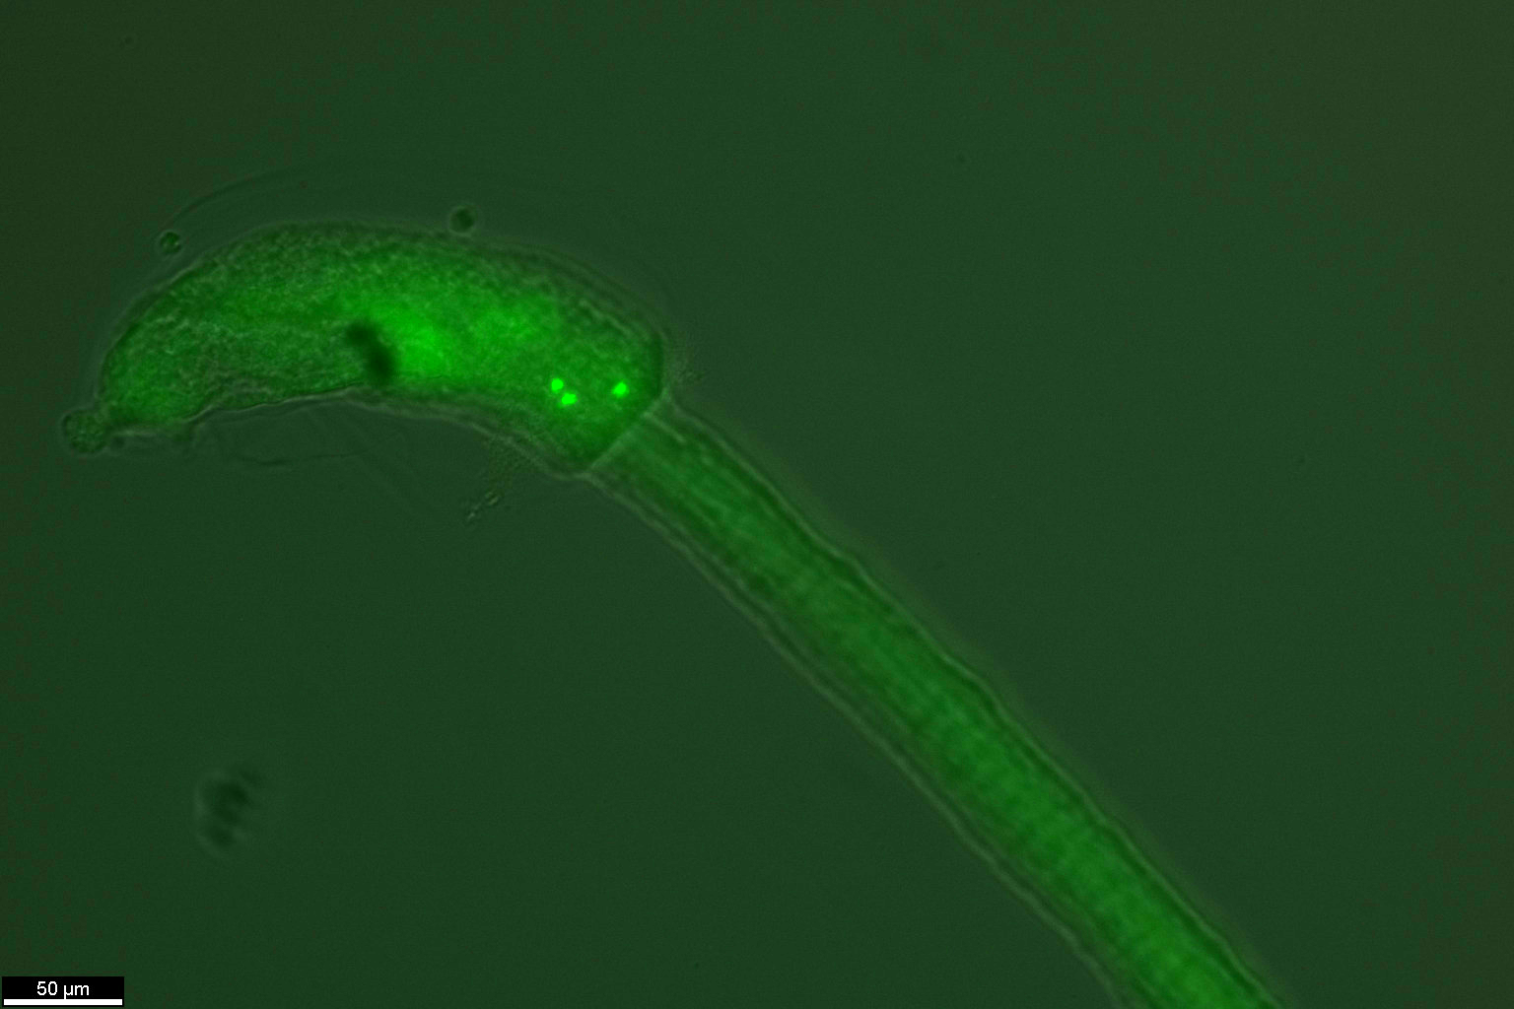
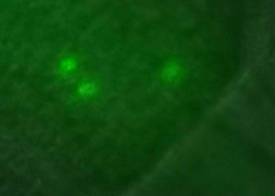
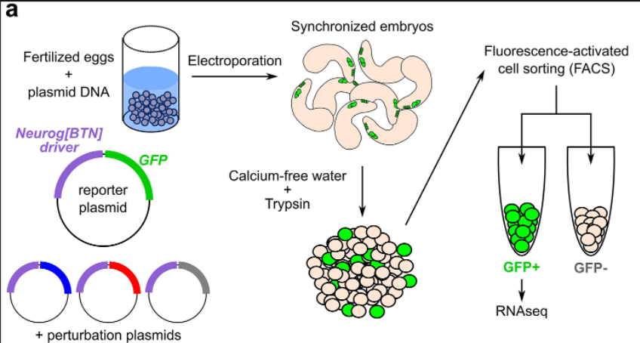
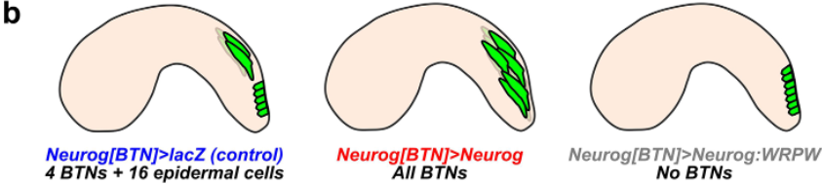
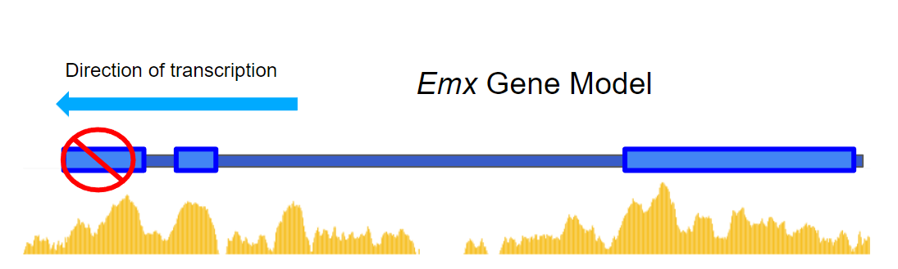
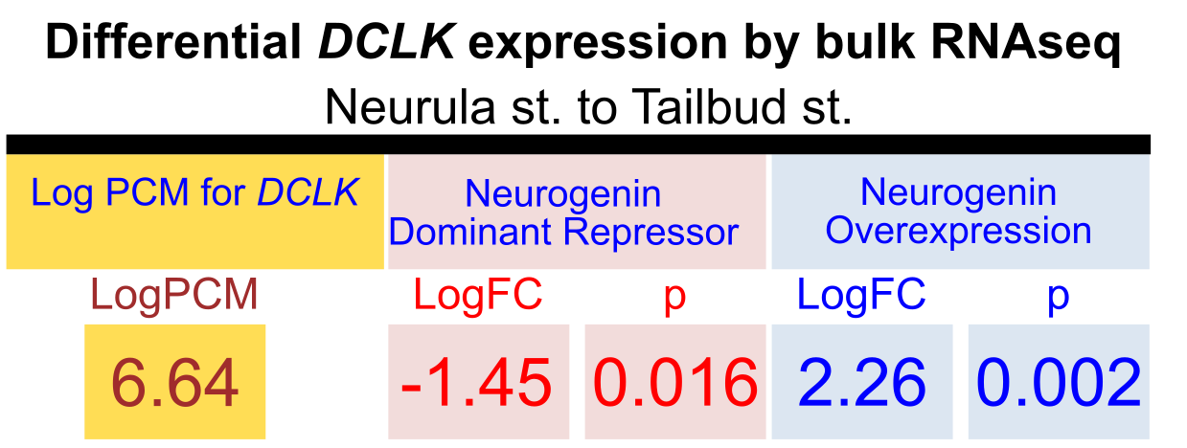
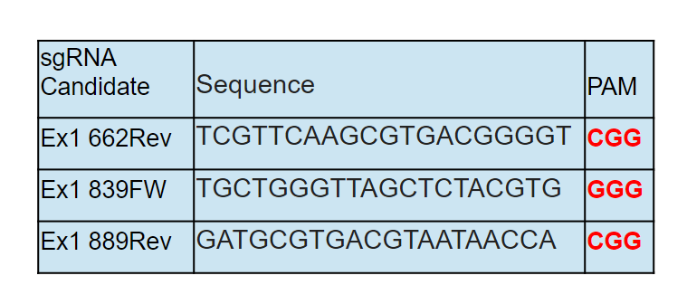
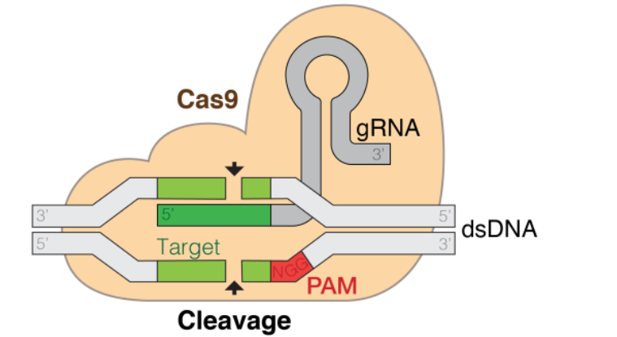
The Roles of DCX and EMX genes in Bipolar Tail Neuron Determination in the Nonvertebrate Chordate, Ciona robusta
Elizabeth Singh¹, Leilt Seleshi¹, John Pilger¹, Sydney Popsuj^{1,2}, Alberto Stolfi²
¹Agnes Scott College, Department of Biology
² Georgia Institute of Technology, College of Biological Sciences
Introduction to Ciona robusta
Identifying Regulatory Modules of DCLK
Validation of Emx Guide RNAs
Tunicates are the closest non-vertebrate genetic relative of humans.
The tunicate Ciona robusta is an ideal model organism to study the development of bipolar tail neurons due to only having vertebrate-like features like a neural crest in swimming larval form.
Bipolar tail neurons are a type of sensory neuron similarly developed to the dorsal root ganglion.
Previous study from the Stolfi Lab identified thousands of candidate genes via RNA-sequencing that are implicated in BTN development based on their proposed regulation by Neurogenin.
Certain genes found downstream of Neurogenin, a protein needed in the development of BTNs and neurogenesis, showed activity.
This study will look at genes DCX (also known as DCLK) and transcription factor EMX for their roles in bipolar tail neuron differentiation in Ciona robusta.
1A
3A
3C
5A
5B
1B
GFP
DCLK in situ
5C
5D
1C
3B
3B
Fig 1A: Ciona robusta
Fig 1B: Ciona robusta’s biphasic lifestyle as both a mobile larva and immobile adult
Fig1C: Bipolar tail neuron in Ciona robusta larvae (Kim et al. 2020)
Candidate Genes for BTN Differentiation
3D
Fig3A: Suggested BTN activity in DCX from overexpression of neurogenin (Kim et al. 2020)
Fig3B: DCX expressed in Ciona robusta larva and process of verification (Kim et al. 2020)
Fig3C: A tissue specific promoter was inserted as well as plasmid DNA previously extracted from a CRISPR-Cas9 process in order to florence Ciona robusta (Kim et al. 2020)
Fig3D: Fluorescent DCX region after electroporation in Ciona robusta showing activity in the motor ganglion
2A
Fig5A: Process of identifying the 450 base pairs that make up SgRNAs fragments for an example exon
Fig5B: sgRNAs validated through Ubiquidis Cas9
Fig5C: Process of DNA extraction and regions amplification through Next Generation Sequencing (NGS) and PCR process producing millions of DNA fragment copies with NGS fragment primers
Fig5D: Example of the NGS analysis that was performed on the sgRNA mutation rates
Future Directions
hb
Future Directions
Investigate the novel expression of DCX/DCLK in the motor ganglion
Choose another exon from the DCX/DCLK gene to test its effects on BTN development.
If EMX knockout results in no BTN, it could be useful to replicate to RNA sequencing experiment done with neurogenin in Kim et al.
DCLK intron2>bpfogUG 17hpf 20x
Design of Emx Guide RNAs
4A
2B
4C
4B
References
Kim, K., Gibboney, S., Razy-Krajka, F., Lowe, E. K., Wang, W., &amp; Stolfi, A. (2020). Regulation of neurogenesis by FGF signaling and neurogenin in the invertebrate chordate Ciona. Frontiers in Cell and Developmental Biology, 8. https://doi.org/10.3389/fcell.2020.00477
Abitua, P. B., Wagner, E., Navarrete, I. A., & Levine, M. (2012). Identification of a rudimentary neural crest in a non-vertebrate chordate. Nature, 492(7427), 104–107. https://doi.org/10.1038/nature11589
Kim, K., Orvis, J., & Stolfi, A. (2022). Pax3/7 regulates neural tube closure and patterning in a non-vertebrate chordate. Frontiers in cell and developmental biology, 10, 999511. https://doi.org/10.3389/fcell.2022.999511
Fig2A: Process of overexpression of neurogenin in Ciona robusta (Kim et al. 2020)
Fig2B: Logfold Change and P-values needed for the selection of the gene
Fig4A: Process of CRISPR-Cas9 knockout process on transcription factor EMX
Fig4B: CRISPR-Cas9 knockout process, where a small bit of DNA is cut out and left to repair on its own with RNA inserted. This method was used to observe the effect of gene function loss on BTN development (wikimedia commons)
Fig4C: Result of knockout on transcription factor EMX and sgRNA selection
Notes:
Kim et al 2020 https://www.frontiersin.org/articles/10.3389/fcell.2020.00477/full

